Slide 1
DaTa Structures
Stack Data Structure-Applications
By
Zainab Malik

Slide 2
Content
Application of Stack
Symbol Balancing
Polish Notations
Evaluation of Postfix Expression
Conversions of Polish Notations
Infix-to-Postfix Conversion
Infix-to-Prefix Conversion
Postfix-to-Infix Conversion
Prefix-to-Infix Conversion
Postfix-to-Prefix Conversion
Prefix-to-Postfix Conversion
Other Applications

Slide 3
Stack Application-Symbol Balancing
Create an empty stack of char
Read input text char by char till the end of input
2.1. If char is an opening symbol, push it on the stack
2.2. If char is a closing symbol
2.2.1. If stack is empty, report an error ("Opening symbol missing”)
2.2.2. If stack is non-empty, pop a char from stack and match it with input char. If both characters do not match then report an error (“Symbol mismatch”)
At the end of input, if stack is non-empty then report an error (“Closing Symbol missing”)

Slide 4
Stack Application-Symbol Balancing
0 | 1 | 2 | 3 | 4 | 5
( | [ | ( | ) | ] | )
Valid String or symbols are balanced

Slide 5
Stack Application-Symbol Balancing
0 | 1 | 2 | 3 | 4 | 5
( | [ | ( | ] | ) | )
Invalid String or symbols are mismatched

Slide 6
Stack Application-Symbol Balancing
0 | 1 | 2 | 3 | 4
( | [ | ) | ] | )
Invalid String or Opening symbol is missing

Slide 7
Stack Application-Symbol Balancing
0 | 1
) | ]
Invalid String or Opening symbol is missing

Slide 8
Polish Notations
Infix Expression (a+b)
Prefix Expression (+ab)
Postfix Expression (ab+)
Computer System uses postfix notation to evaluate an expression.

Slide 9
Stack Application-Postfix Evaluation
1. Create an empty stack of type double
2. Read input postfix expression char by char till the end of input
2.1. If char is an operand, convert it into its double equivalent and then push it on the stack
2.2. If char is an operator then pop two elements from the stack, perform the operation and push the result back on the stack.
3. At the end of input, Pop the final result and return it

Slide 10
Infix-to-postfix manually
9 – 5 / 3 + 5 * 2
9 - 53/ + 5 * 2
953/- + 5 * 2
953/- + 52*
953/-52*+

Slide 11
Postfix Evaluation: 953/-52*+
Scanned Character | Stack | Operation | Rule
9 | 9 |  | 2.1
5 | 9,5 |  | 2.1
3 | 9,5,3 |  | 2.1
/ | 9 | 5/3=1.67 | 2.2
 | 9 ,1.67
- |  | 9 - 1.67=7.33 | 2.2
 | 7.33
5 | 7.33, 5 |  | 2.1
2 | 7.33, 5, 2 |  | 2.1
* | 7.33 | 5*2=10 | 2.2
 | 7.33,10
+ |  | 7.33+10=17.33 | 2.2
 | 17.33
 |  |  | 3
Output | 17.33

Slide 12
Stack Application-(infix-to-postfix conversion)
1.Create an empty stack of type char
2.Read input expression char by char till the end of input
2.1.Operand: display it
2.2.Opening Parenthesis: push
2.3.Operator:
2.3.1. If stack is empty then push it
2.3.2. If stack is non-empty then pop characters from stack and display them until we find an operator of lower precedence or an opening parenthesis or stack become empty. When popping is done push the current operator on to the stack.
2.4.Closing Parenthesis: Pop operators from stack and display them until we pop an opening parenthesis which will be popped but not displayed.
3.At the end of input, if stack is non-empty, pop operators from stack and display them until the stack becomes empty.

Slide 13
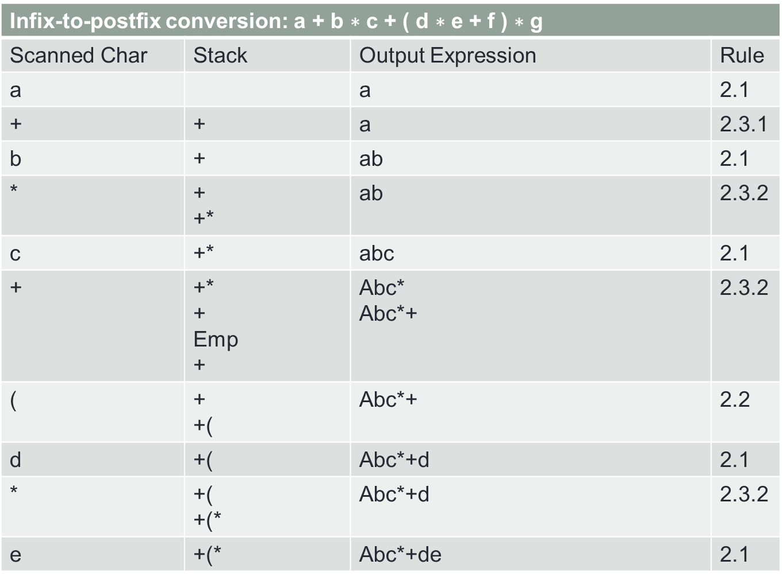
Infix-to-postfix conversion: $\text{a} \text{+} \text{b} \text{∗} \text{c} \text{+} \text{(} \text{d} \text{∗} \text{e} \text{+} \text{f} \text{)} \text{∗} \text{g}$
Scanned Char | Stack | Output Expression | Rule
a |  | a | 2.1
+ | + | a | 2.3.1
b | + | ab | 2.1
* | + +* | ab | 2.3.2
c | +* | abc | 2.1
+ | +* + Emp + | Abc* Abc*+ | 2.3.2
( | + +( | Abc*+ | 2.2
d | +( | Abc*+d | 2.1
* | +( +(* | Abc*+d | 2.3.2
e | +(* | Abc*+de | 2.1

Slide 14
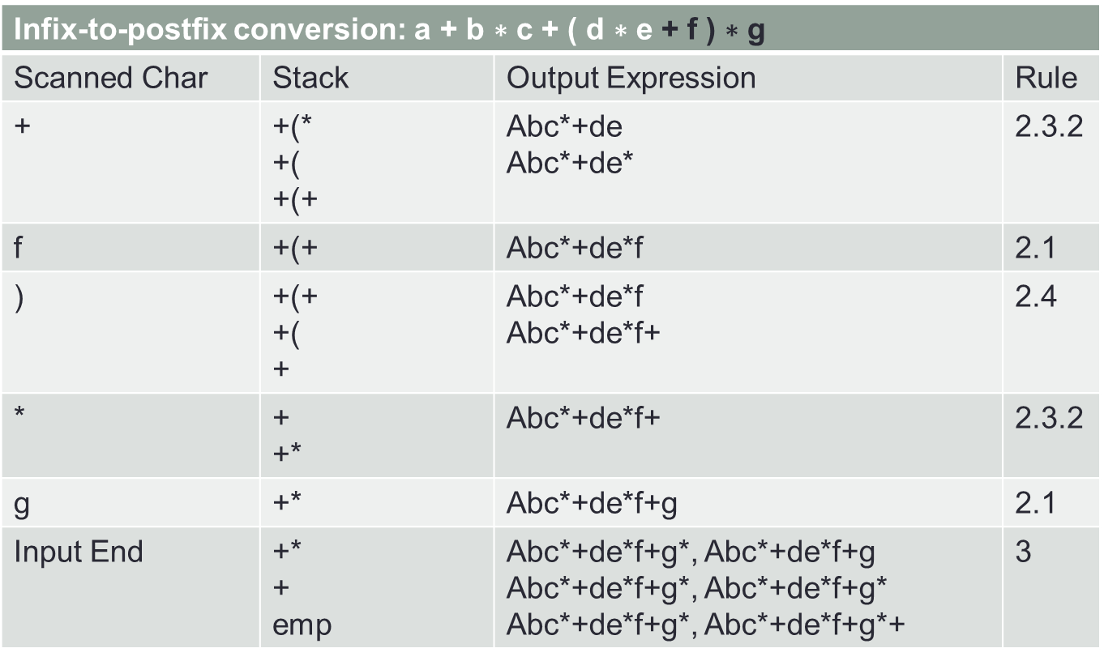
Infix-to-postfix conversion: $\text{a} \text{+} \text{b} \text{∗} \text{c} \text{+} \text{(} \text{d} \text{∗} \text{e} \text{+} \text{f} \text{)} \text{∗} \text{g}$
Scanned Char | Stack | Output Expression | Rule
+ | +(* +( +(+ | Abc*+de Abc*+de* | 2.3.2
f | +(+ | Abc*+de*f | 2.1
) | +(+ +( + | Abc*+de*f Abc*+de*f+ | 2.4
* | + +* | Abc*+de*f+ | 2.3.2
g | +* | Abc*+de*f+g | 2.1
Input End | +* + emp | Abc*+de*f+g*, Abc*+de*f+g Abc*+de*f+g*, Abc*+de*f+g* Abc*+de*f+g*, Abc*+de*f+g*+ | 3

Slide 15
Stack Application-(infix-to-prefix conversion)
1.Create an empty stack of type char
2.Create an output string
3.Reverse the input expression
4.Read the reversed input expression char by char till the end of input
4.1.Operand: add to a output string
4.2.Closing Parenthesis: push
4.3.Operator:
4.3.1.If stack is empty then push it
4.3.2.If stack is non-empty then pop characters from stack and add them to output string until we find an operator with lower or equal precedence or an closing parenthesis or stack become empty. When popping is done push the current operator on to the stack.
4.4.Opening Parenthesis: Pop operators from stack and add them to output string until we pop a closing parenthesis which will be popped but not be added to output string.
5. At the end of input, if stack is non-empty, pop operators from stack and add them to output string until the stack becomes empty.
6. Reverse the output string and display it.

Slide 16
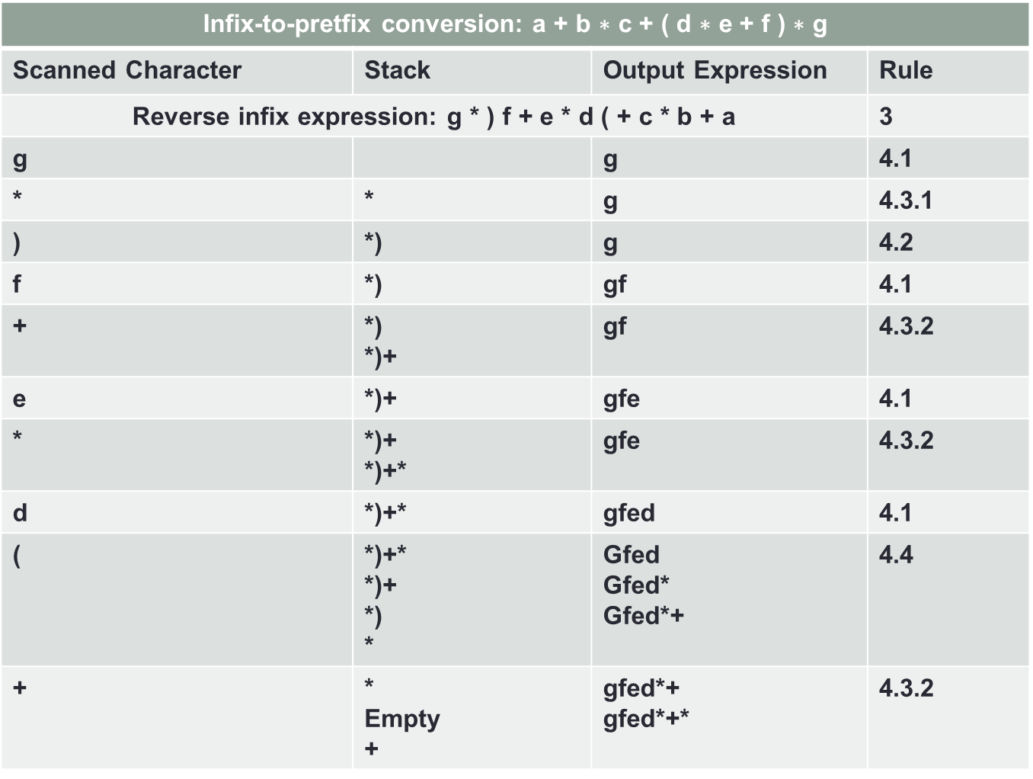
Infix-to-pretfix conversion: $\text{a} \text{+} \text{b} \text{∗} \text{c} \text{+} \text{(} \text{d} \text{∗} \text{e} \text{+} \text{f} \text{)} \text{∗} \text{g}$
Scanned Character | Stack | Output Expression | Rule
Reverse infix expression: g * ) f + e * d ( + c * b + a |  |  | 3
g |  | g | 4.1
* | * | g | 4.3.1
) | *) | g | 4.2
f | *) | gf | 4.1
+ | *) *)+ | gf | 4.3.2
e | *)+ | gfe | 4.1
* | *)+ *)+* | gfe | 4.3.2
d | *)+* | gfed | 4.1
( | *)+* *)+ *) * | Gfed Gfed* Gfed*+ | 4.4
+ | * Empty + | gfed*+ gfed*+* | 4.3.2

Slide 17
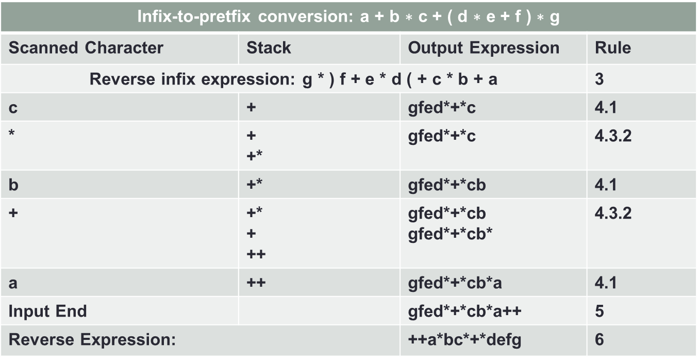
Infix-to-pretfix conversion: $\text{a} \text{+} \text{b} \text{∗} \text{c} \text{+} \text{(} \text{d} \text{∗} \text{e} \text{+} \text{f} \text{)} \text{∗} \text{g}$
Scanned Character | Stack | Output Expression | Rule
Reverse infix expression: g * ) f + e * d ( + c * b + a |  |  | 3
c | + | gfed*+*c | 4.1
* | + +* | gfed*+*c | 4.3.2
b | +* | gfed*+*cb | 4.1
+ | +* + ++ | gfed*+*cb gfed*+*cb* | 4.3.2
a | ++ | gfed*+*cb*a | 4.1
Input End |  | gfed*+*cb*a++ | 5
Reverse Expression: |  | ++a*bc*+*defg | 6

Slide 18
Stack Application-(postfix-to-infix conversion)
1. Create an empty stack of type string
2. Read the input postfix expression char by char till the end of input
2.1.If the char is an operand: push it on the stack
2.2.It the char is operator: Pop two operands from stack from an infix sub-expression and push the sub-expression back on the stack.
3. At the end of the input pop the resultant infix expression from the stack and display it

Slide 19
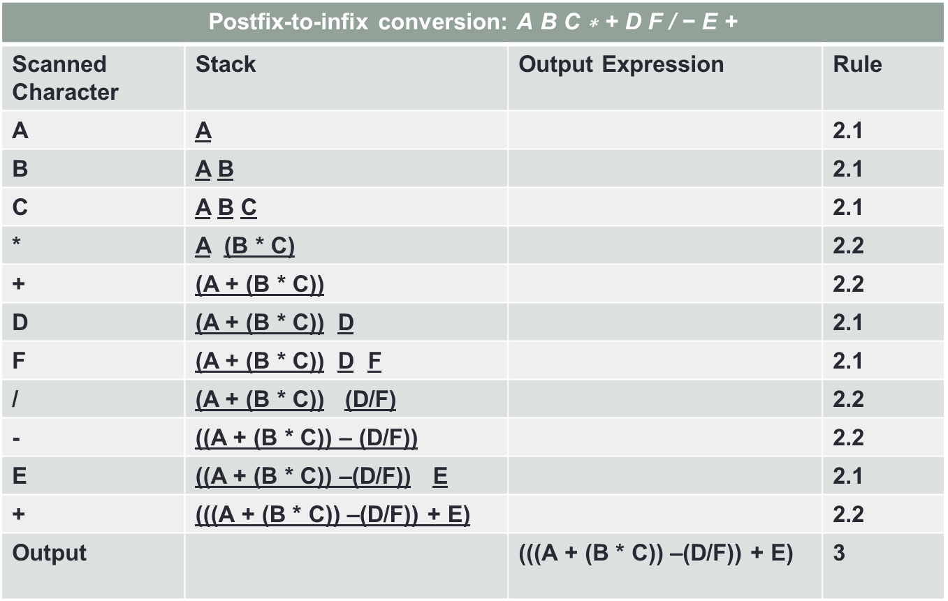
Postfix-to-infix conversion: $\text{A} \text{B} \text{C}\text{ ∗ + }\text{D} \text{F}\text{ / − }\text{E}\text{ +}$
Scanned Character | Stack | Output Expression | Rule
A | A |  | 2.1
B | A B |  | 2.1
C | A B C |  | 2.1
* | A (B * C) |  | 2.2
+ | (A + (B * C)) |  | 2.2
D | (A + (B * C)) D |  | 2.1
F | (A + (B * C)) D F |  | 2.1
/ | (A + (B * C)) (D/F) |  | 2.2
- | ((A + (B * C)) – (D/F)) |  | 2.2
E | ((A + (B * C)) –(D/F)) E |  | 2.1
+ | (((A + (B * C)) –(D/F)) + E) |  | 2.2
Output |  | (((A + (B * C)) –(D/F)) + E) | 3

Slide 20
Stack Application-(prefix-to-infix conversion)
1. Create an empty stack of type string
2. Reverse the input expression
3. Read the reversed input prefix expression char by char till the end of input
3.1.If the char is an operand: push it on the stack
3.2.It the char is operator: Pop two operands from stack from an infix sub-expression )( and push the sub-expression back on the stack.
4. At the end of the input pop the resultant expression from the stack, reverse and display it.

Slide 21
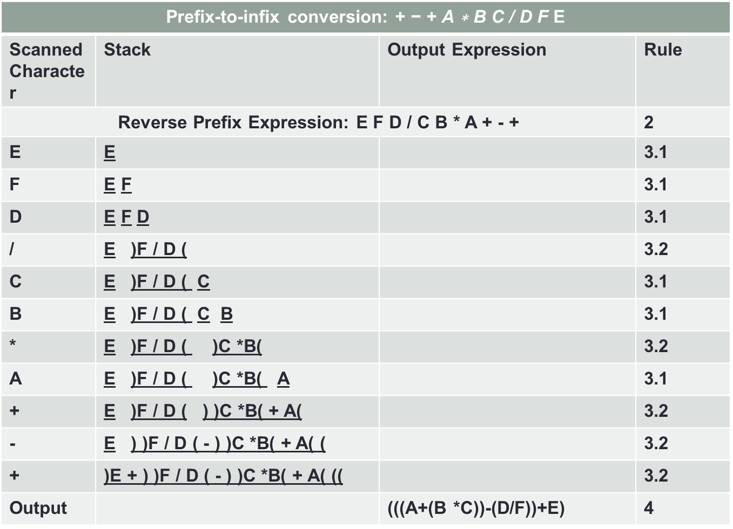
Prefix-to-infix conversion: $\text{+ − + }\text{A}\text{ ∗ }\text{B} \text{C}\text{ / }\text{D} \text{F}$E
Scanned Character | Stack | Output Expression | Rule
Reverse Prefix Expression: E F D / C B * A + - + |  |  | 2
E | E |  | 3.1
F | E F |  | 3.1
D | E F D |  | 3.1
/ | E )F / D ( |  | 3.2
C | E )F / D ( C |  | 3.1
B | E )F / D ( C B |  | 3.1
* | E )F / D ( )C *B( |  | 3.2
A | E )F / D ( )C *B( A |  | 3.1
+ | E )F / D ( ) )C *B( + A( |  | 3.2
- | E ) )F / D ( - ) )C *B( + A( ( |  | 3.2
+ | )E + ) )F / D ( - ) )C *B( + A( (( |  | 3.2
Output |  | (((A+(B *C))-(D/F))+E) | 4

Slide 22
Stack Application-(prefix-to-postfix conversion)
1. Apply prefix-to-infix conversion
2. Apply infix-to-postfix conversion

Slide 23
Stack Application-(postfix-to-pretfix conversion)
1. Apply postfix-to-infix conversion
2. Apply infix-to-prefix conversion

Slide 24
Other Applications
Any modern computer environment uses a stack as the primary memory management model for a running program.
Manages the nested features of any programming language
Manages the recursive calls of a recursive function etc.
Stack data structures are used in backtracking problems.

Slide 25
Thank You

